Slide 1
Content-based Social Media
Payam Khaninejad
http://khaninejad.ir

Slide 2

Notes:
Social media is the collective of online communications channels dedicated to community-based input, interaction, content-sharing and collaboration.
Websites and applications dedicated to forums, microblogging, social networking, social bookmarking, social curation, and wikis are among the different types of social media.

Slide 3
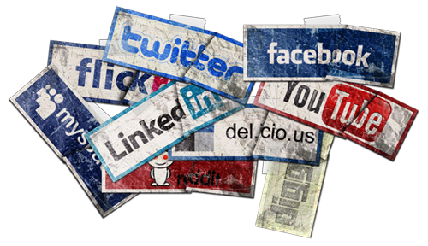
Disadvantages of Social Networking
Notes:
Lacks Emotional Connection
Gives People a License to be Hurtful
Decreases Face-to-Face Communication Skills
Conveys Inauthentic Expression of Feelings
Diminishes Understanding and Thoughtfulness
Causes Face-to-Face Interactions to Feel Disconnected
Facilitates Laziness
Creates a Skewed Self-Image
Reduces Family Closeness
Causes Distractions

Slide 4
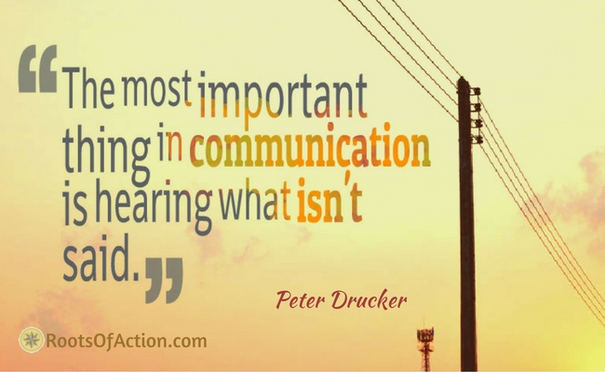

Slide 5
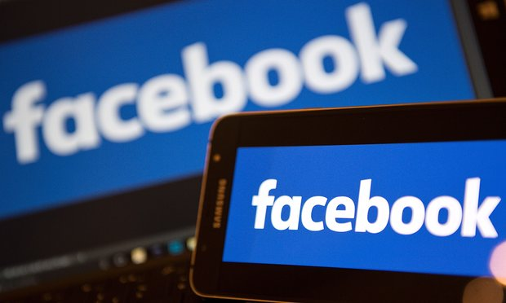
Fake News?
Notes:
Roots of Action Tree
Home The Compass Articles Resources Book About Contact
Facebook will begin flagging fake news stories with the help of users and outside fact checkers, the company announced on Thursday, responding to a torrent of criticism over fake news during the US election.
Readers will be able to alert Facebook to possible fake news stories, which the social media behemoth will then send to outside fact-checking organizations to verify.

Slide 6
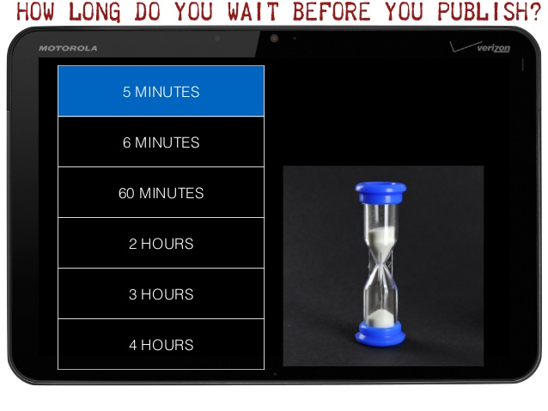
The pope and the dictator

Slide 7


Slide 8
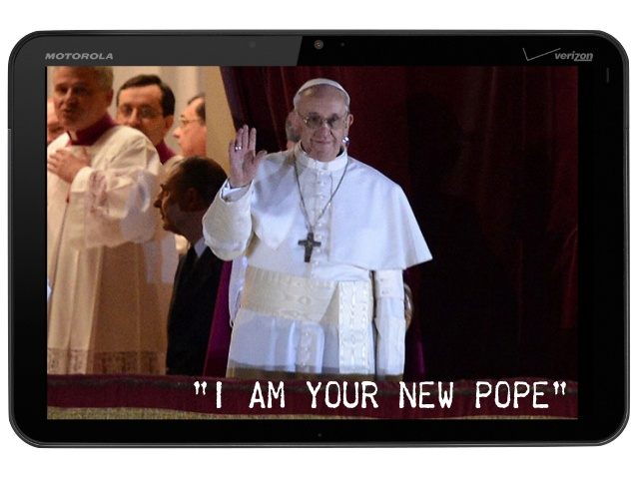

Slide 9
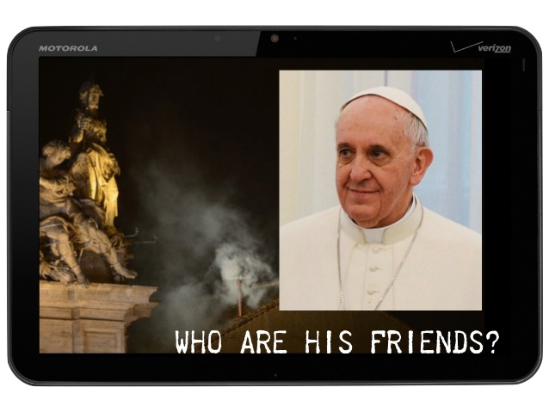

Slide 10
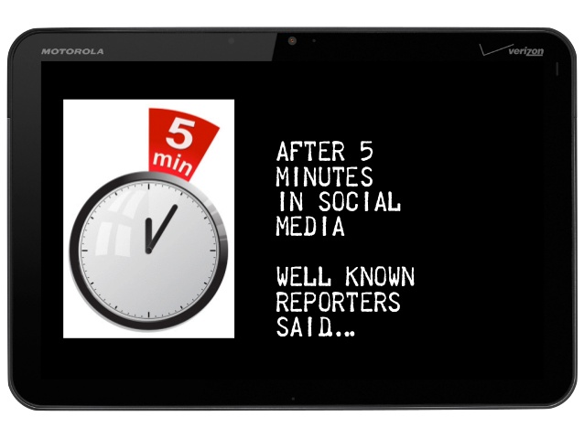

Slide 11
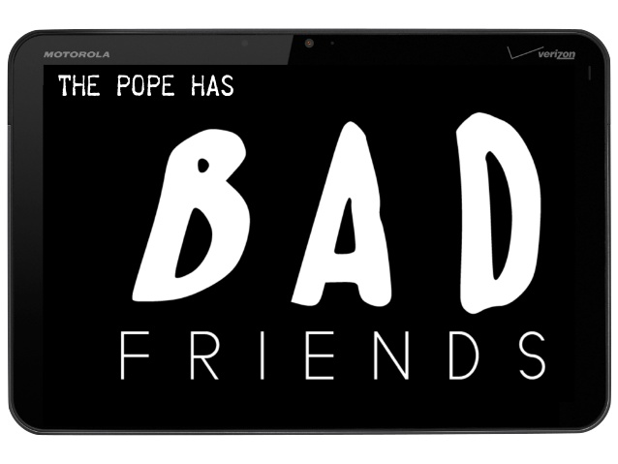

Slide 12
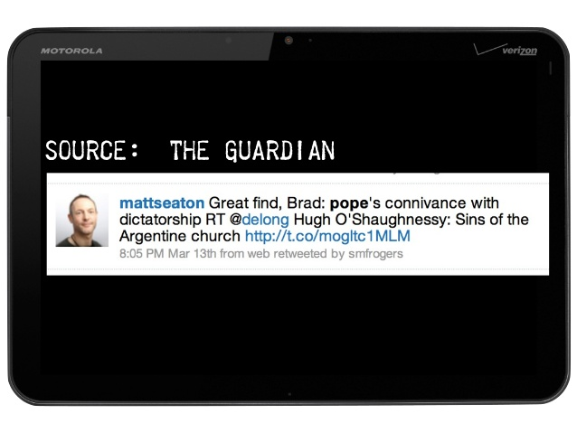

Slide 13
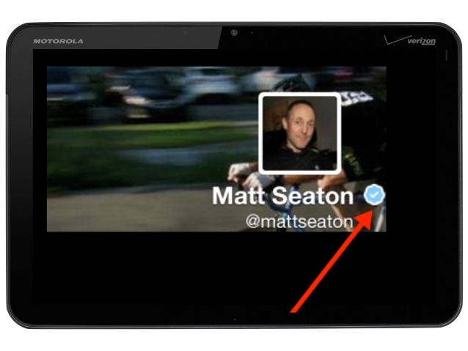

Slide 14
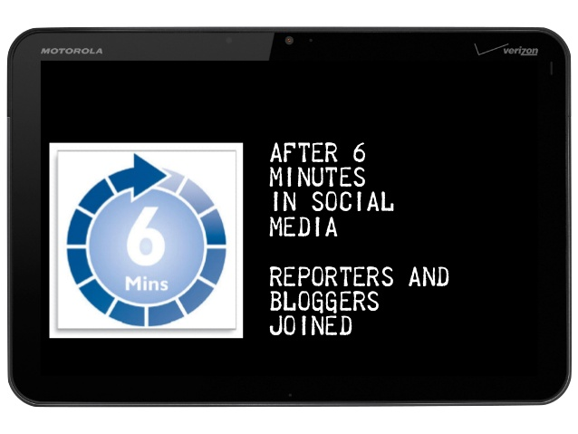

Slide 15
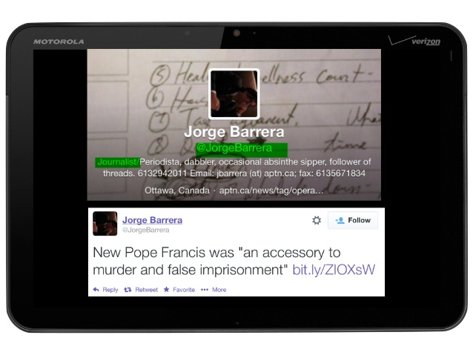

Slide 16
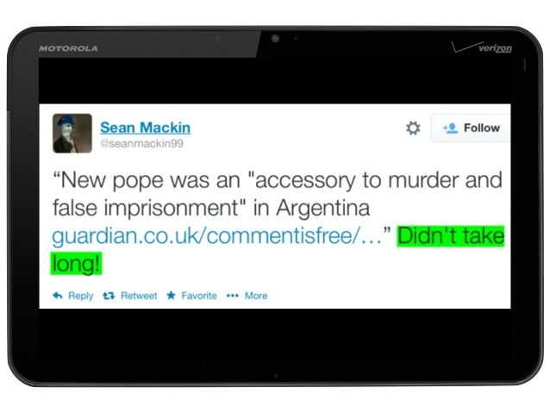

Slide 17


Slide 18
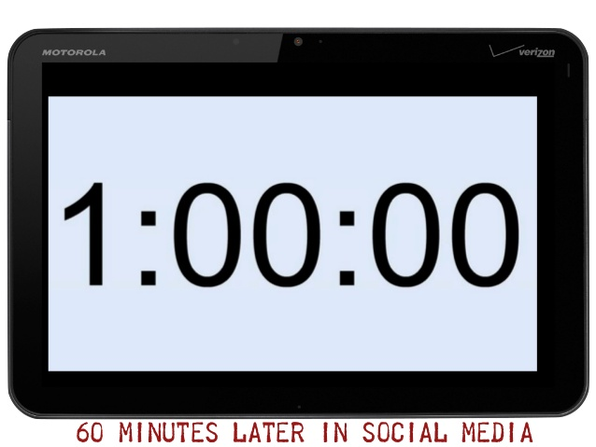

Slide 19
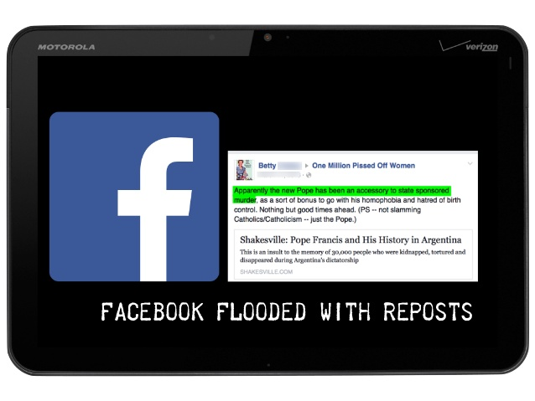

Slide 20
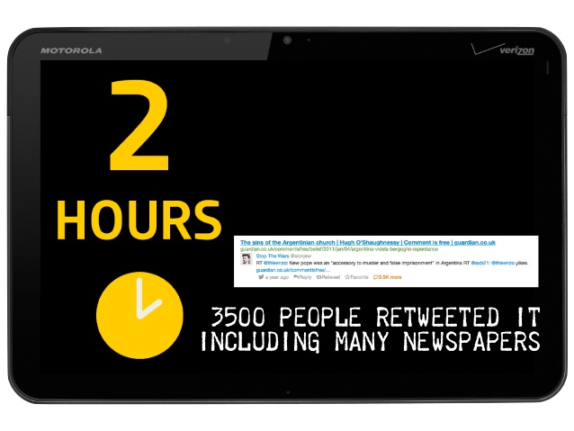

Slide 21
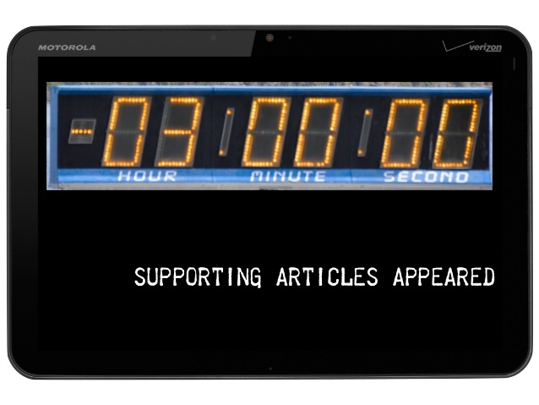

Slide 22
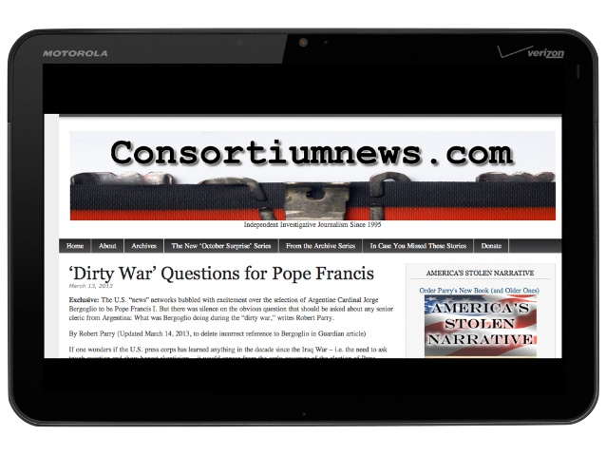

Slide 23


Slide 24
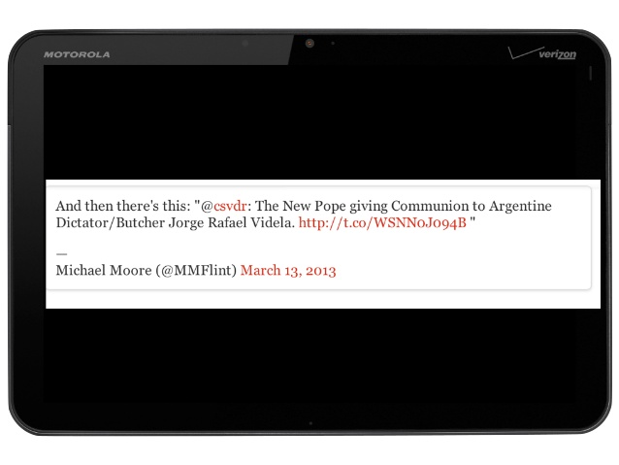

Slide 25
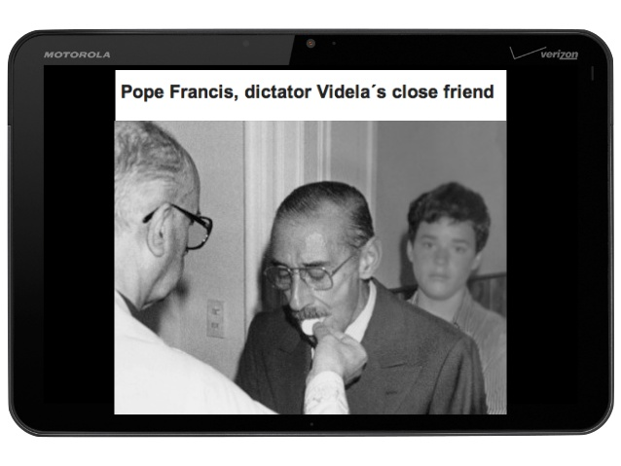

Slide 26
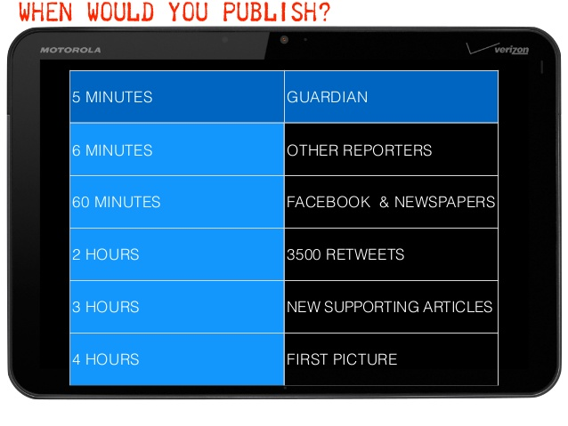

Slide 27
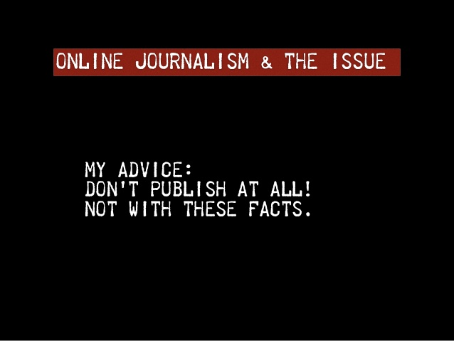

Slide 28
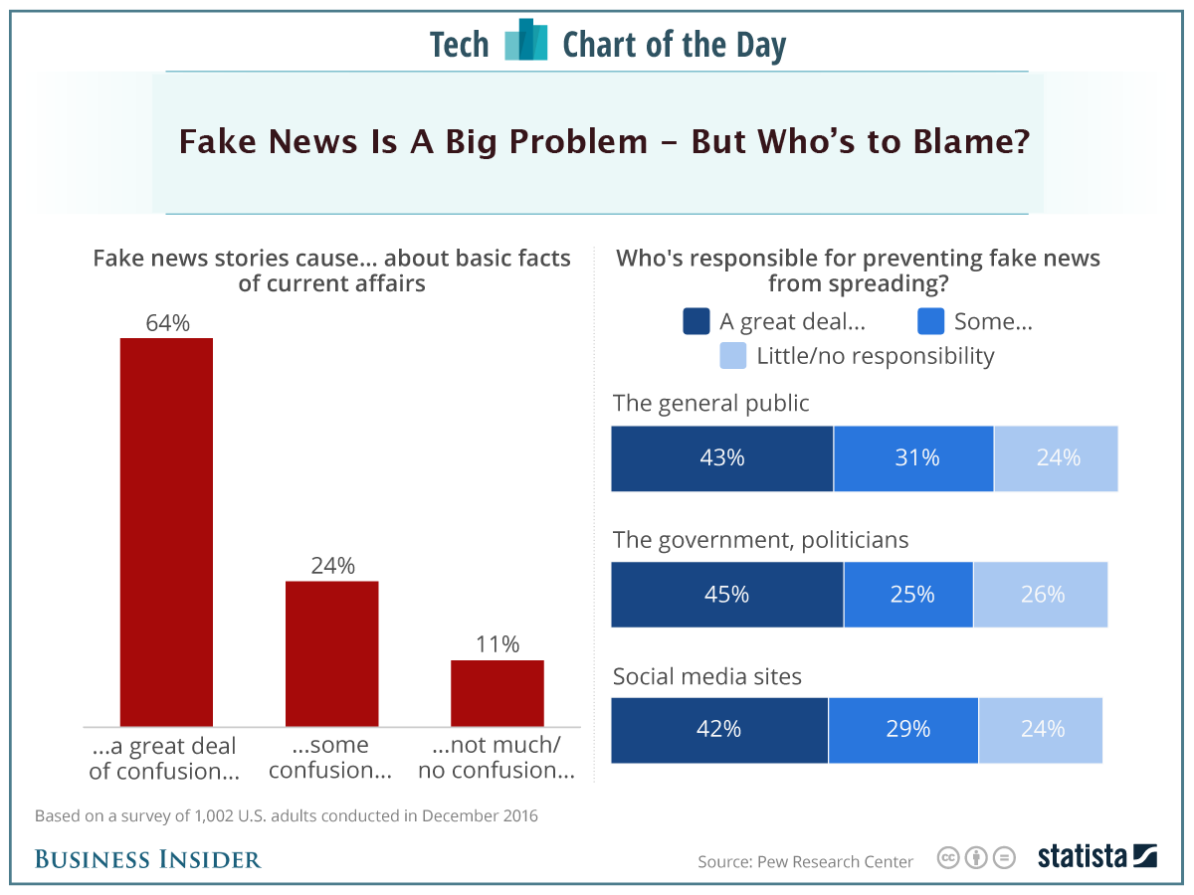

Slide 29
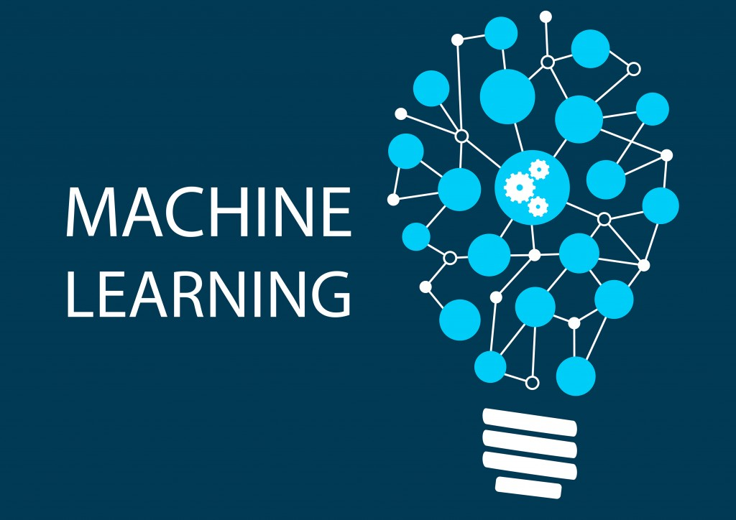
Solution?

Slide 30
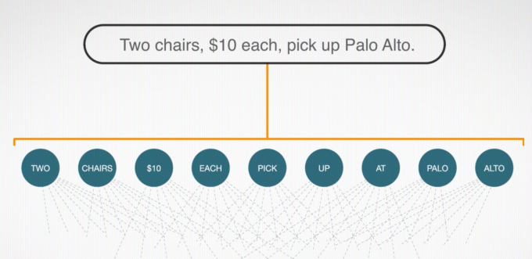
Categorize Text
Notes:
Deep Text uses unsupervised machine learning to understand humans and interpret what they say

Slide 31
News Validation?
1- Find Original Source
2- Who is talking
3- Check Context
4- Don’t go for mess
5- verify unknown sources
6- verify Image
7- Check claims
8- Video?
9- Check if other say? UnTrue
10- Use real time services

Slide 32
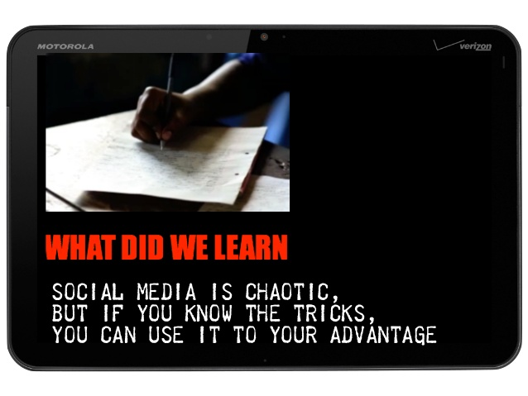

Slide 33
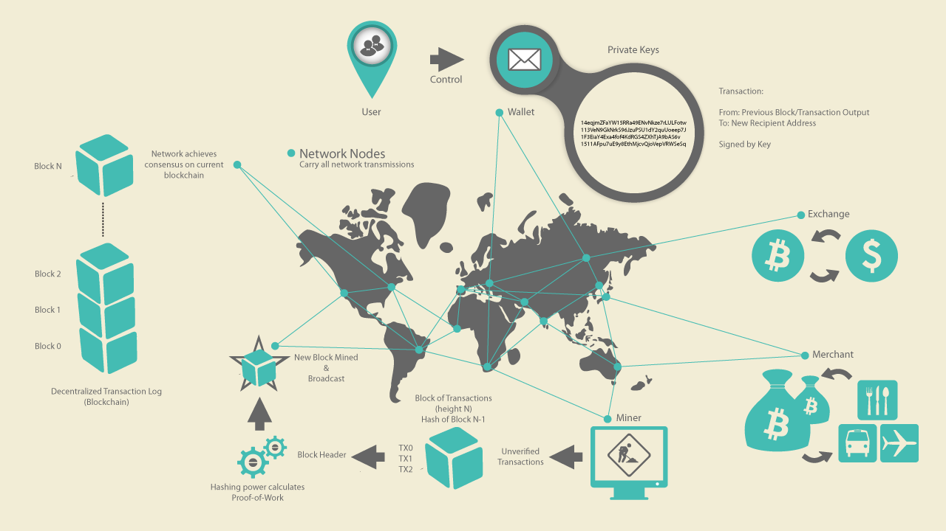
Need new protocol

Slide 34
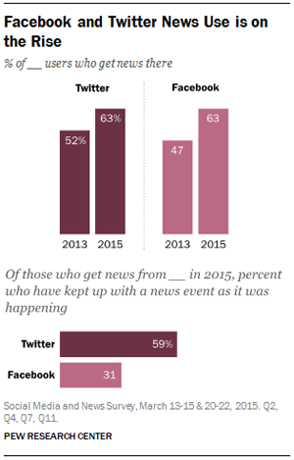
Users behaviors

Slide 35
Analysis of Social Graphs
Social Network Analysis
User Interaction Analysis
Mini-feed Analysis

Slide 36
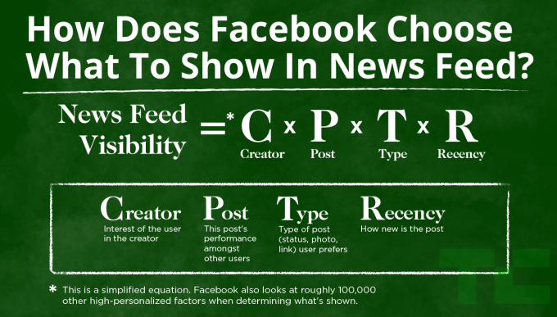
Indexing Algorithm

Slide 37

Result?

Slide 38
Thank You
Payam Khaninejad

